Slide 1
National Enterprise Development
Authority
Physical Progress - 2018
District Coordinator
Jaffna District

Slide 2
Enterprise forum and issue tracker
Program | Annual Target | Achievement
Enterprise forum and issue tracker
No. of REF established | 14 | 11
No. of DEF meetings conducted | 1 | - (Not send the proposal District Secretary not allowed the program)
No. of business issues identified | 80 | 66
No. of solutions taken | 60 | 43
No. of issues enter in to issue tracker ( If applicable) | 8 | -

Slide 3
Regional enterprise Development Programm
Regional enterprise development program
Program | Annual Target | Achievement
No. of entrepreneurs trained | Male Female 100 600 | Male Female 74 500
No. of entrepreneurs developed | 100 600 | 50 140
No. of new products introduced to market | 50 60 | 30 38
No. of entrepreneurs financial assisted | 20 60 | 6 25

Slide 4
Regional enterprise development program
Program | Annual Target | Achievement
No. of employees generated | Male Female 80 100 | Male Female 24 50
No. of business facilitated for registration | 30 40 | 20 35
No. of business plan prepared | 20 20 | 6 10

Slide 5
Progress 2018 con/.
Program | Annual Target | Achievement
Business Development Service ( BDS) Directory ( DS Level) - No. of BDS Providers introduced into DS Level BDS Directory ( Total BDS Providers) | 250 | 206
MSME Data Base ( DS Level) - No. of MSMEs introduced into DS Level Directory ( Total MSMEs) | 5000 | 4797

Slide 6
Progress 2018 con/.
Program | Annual Target | Achievement
Entrepreneur Awarding ceremony No. of entrepreneurs introduced - No. of entrepreneurs win awards | 1 80 20 | 1 64 14
Business fair/exhibition No. of Business fairs conducted No. of entrepreneurs introduced to fair/exhibition | 1 120 | 2 84

Slide 7
Progress 2018 con/.
Program | Annual Target | Achievement
Packaging training program No. of entrepreneurs trained No. of entrepreneurs link to super market/ new market | 2 100 | - 75(Pending fund allocated Resource person will conduct in 2019)
Cluster/ sector Development program - No. entrepreneurs trained - No. entrepreneurs Developed | 1 30 30 | 1 30 30

Slide 8
Progress 2018 con/.
Program | Annual Target | Achievement
Upadhidari Vyavasayake Udanaya (UVU)program No. of graduates identifies through University/ field No. of graduates trained No. of entrepreneurs provide grant | - - - - | 15 75 30 15
Incubator & technology transfer center at Wayamba University ( If applicable) - No. of entrepreneurs introduced | - | Not applicable in the Jaffna District.

Slide 9
Progress 2018 con/.
Program | Annual Target | Achievement
Evaluating SMEs in supportive knowhow ( Business rules & regulation awareness program) - No. of entrepreneurs introduced | 250 | 206
Development of youth entrepreneurs through vocational trainees ( If applicable) - No. of youths introduced to program | - | Not applicable in Jaffna District.

Slide 10
Program: Apparel Based Mini Garment Factories Project
( Mention Yes)
DS Division | Location | Working at least few machines | Started initial activities to establish as a corporative / partnership business | Established corporative/ partnership business | Documents submit to registration | Registered | Income earning
Jaffna | Jaffna Division | Yes | Initial Progress is Going on | Initial Progress is Going on | Yes | No | -
Chankanai | RDS Building | Yes | Initial Progress is Going on | Initial Progress is Going on | Yes | No | -
Uduvil | Mylankadu Division | Yes | Initial Progress is Going on | Initial Progress is Going on | Yes | No | -

Slide 11
Program: Special Entrepreneurship Development Program
(2017/2018)
DS Division | Allocation ( Rs.) | No. of Beneficiaries identified | No. of beneficiaries provided machineries | Advance settlements ( Yes/ No)
Dijadda Udanaya | 10.63 | 303 | 286 | Yes

Slide 12
National Enterprise Development Authority
Physical Progress - 2019
District : Jaffna

Slide 13
General Description
No. of DS Divisions:14
No. of Development Officers :14
Major Business Sectors: Agriculture,Fisheries,Garments,Handicraft,Coir based product, Leather product,Palmyrah products etc….
Other information:

Slide 14
Progress 2019
Program | Annual Target | Achievement
Enterprise forum and issue tracker No. of REF established No. of DEF meetings conducted No. of business issues identified No. of solutions taken No. of issues enter in to issue tracker ( If applicable) | 14 10 10 10 | Ongoing (Proposed to conduct from next week) Ongoing

Slide 15
Progress 2019 con/.
Program | Annual Target | Achievement
Regional enterprise development program No. of entrepreneurs trained No. of entrepreneurs developed No. of new products introduced to market No. of entrepreneurs financial assisted No. of employees generated No. of business facilitated for registration No. of business plan prepared | Male Female 120 500 80 400 50 200 60 100 65 165 50 60 90 160 | Male Female 05 107 05 107 03 50 01 40 03 30 08 10 65

Slide 16
Progress 2019 con/.
Program | Annual Target | Achievement
Business Development Service ( BDS) Directory ( DS Level) - No. of BDS Providers introduced into DS Level BDS Directory ( Total BDS Providers) | 280 | 170
MSME Data Base ( DS Level) - No. of MSMEs introduced into DS Level Directory ( Total MSMEs) | 3000 | 2500

Slide 17
Progress 2019 con/.
Program | Annual Target | Achievement
Entrepreneur Awarding ceremony No. of entrepreneurs introduced - No. of entrepreneurs win awards | 60 25 | Ongoing
Business fair/exhibition No. of Business fairs conducted No. of entrepreneurs introduced to fair/exhibition | 01 | ongoing 170 [Samurdhi }

Slide 18
Progress 2018 con/.
Program | Annual Target | Achievement
Packaging training program No. of entrepreneurs trained No. of entrepreneurs link to super market/ new market | 80 15 | 15 02
Cluster/ sector Development program - No. entrepreneurs trained - No. entrepreneurs Developed | 45 40 | Ongoing

Slide 19
Progress 2018 con/.
Program | Annual Target | Achievement
Upadhidari Vyavasayake Udanaya (UVU)program No. of graduates identifies through University/ field No. of graduates trained No. of entrepreneurs provide grant | 50 50 15
Incubator & technology transfer center at Wayamba University ( If applicable) - No. of entrepreneurs introduced

Slide 20
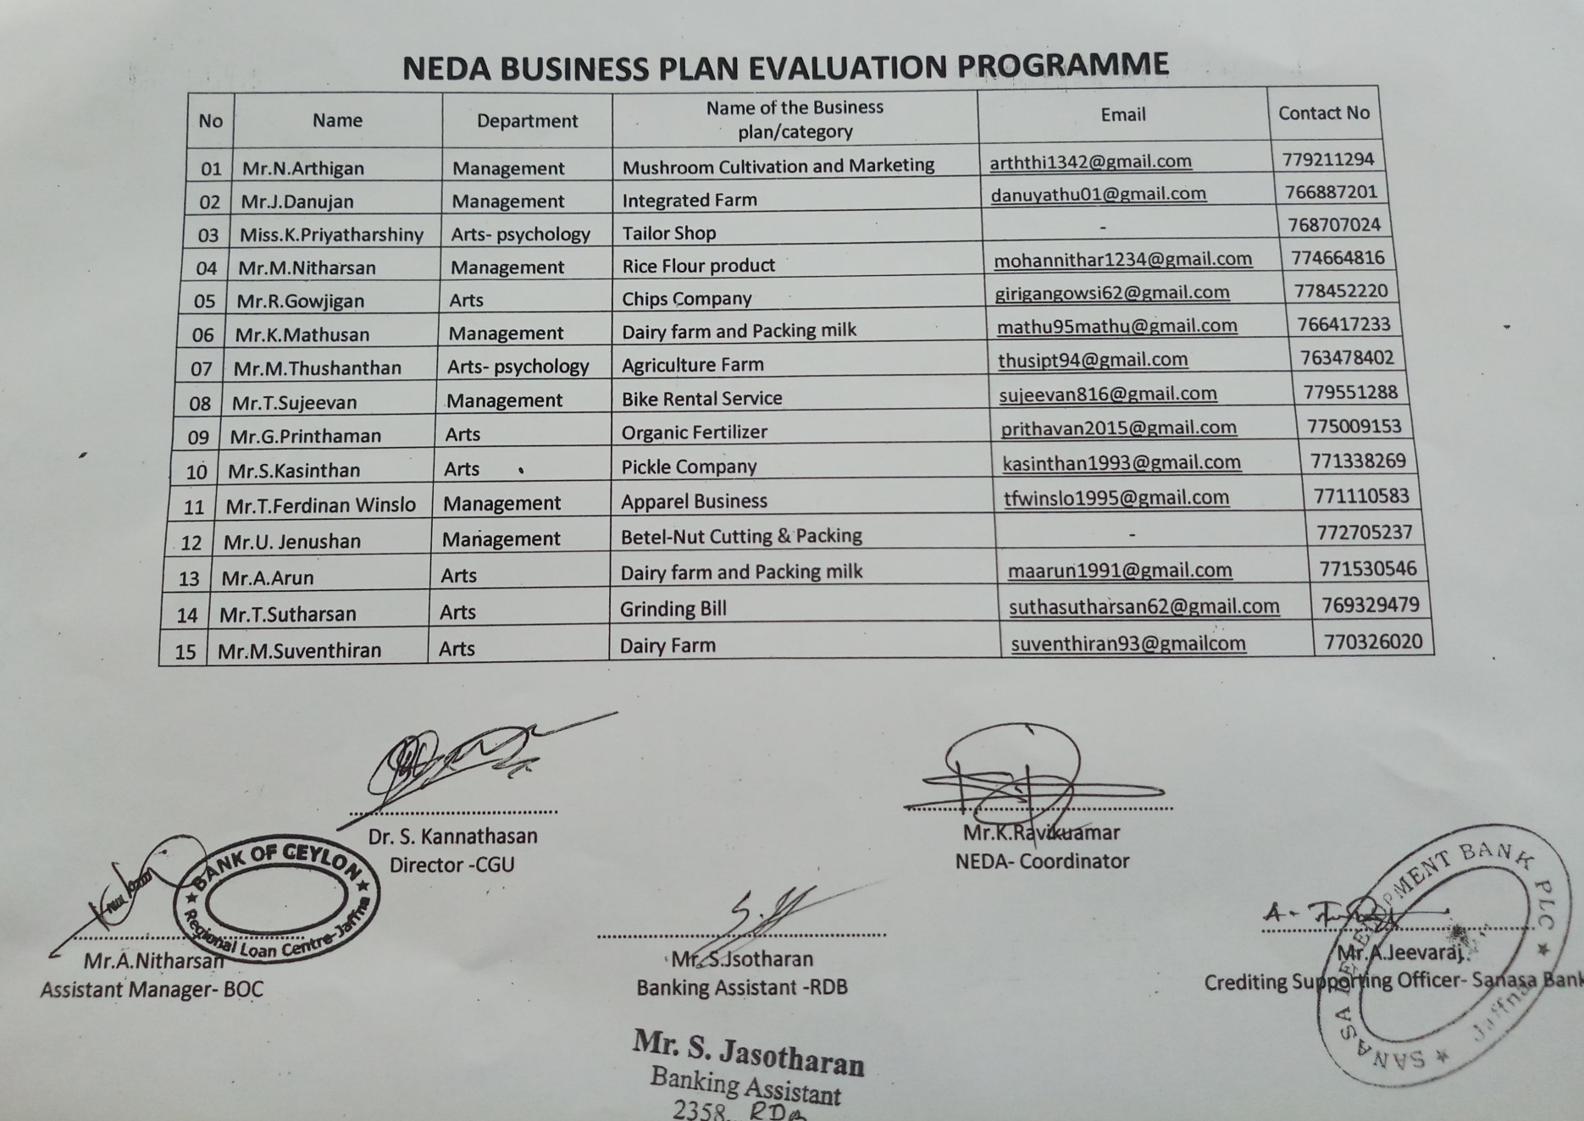

Slide 21
Progress 2018 con/.
Program | Annual Target | Achievement
Evaluating SMEs in supportive knowhow ( Business rules & regulation awareness program) - No. of entrepreneurs introduced | 03 180 | Will conduct on 26th Aug 180
Development of youth entrepreneurs through vocational trainees ( If applicable) - No. of youths introduced to program

Slide 22
Progress 2019 con/.
Program | Annual Target | Achievement
Nanvamu Program No. of entrepreneurs trained | 1500 | 1400
No. of new business established | 1100 | ongoing
No. of expanded business | 500 | ongoing
No. employee generated | 100 | ongoing

Slide 23
Progress 2019 con/.
Program: Apparel Based Mini Garment Factories Project
( Mention Yes/ No)
DS Division | Location | Working at least few machines | Started initial activities to establish as a corporative / partnership business | Established corporative/ partnership business | Documents submit to registration | Registered | Income earning

