Slide 1
ANNUAL PROGRESS - 2019
Early Childhood Development
Divisional Secretariat, Jaffna
  Preschool Programme
  Morning Meals Programme
  Awarness Programme
  Early Childhood Development Project
  5. Pregnant Mothers Programme
  6. Other activities

Slide 2
Morning Meals Programme - 2019
No | Month | No of Students | Expenditure
1 | January | 215 | 79,500.00
2 | February | 210 | 109,050.00
3 | March | 215 | 126,450.00
4 | April
5 | May | 214 | 930,030.00
6 | June | 213 | 125,310.00
7 | July | 213 | 140,580.00
8 | August
9 | September | 895 | 508,320.00
10 | October | 898 | 588,060.00
11 | November | 900 | 540,030.00
12 | December
Total |  |  | 2,310,330.00

Slide 3
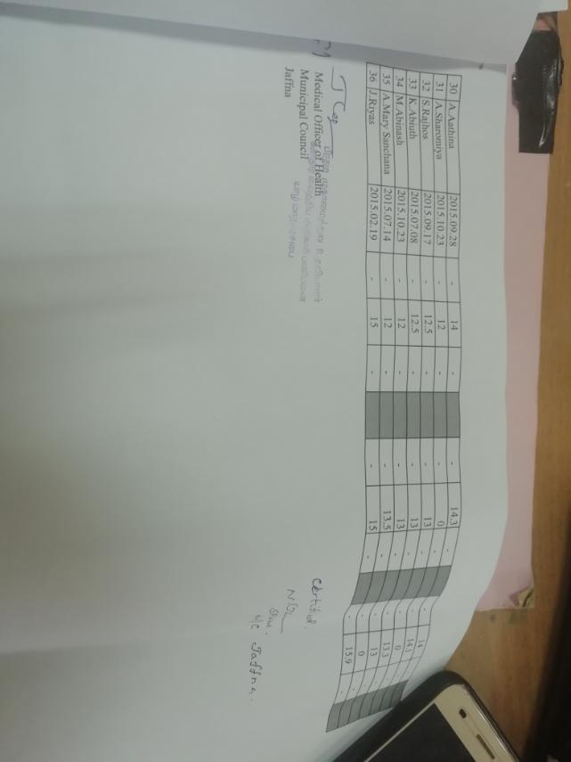
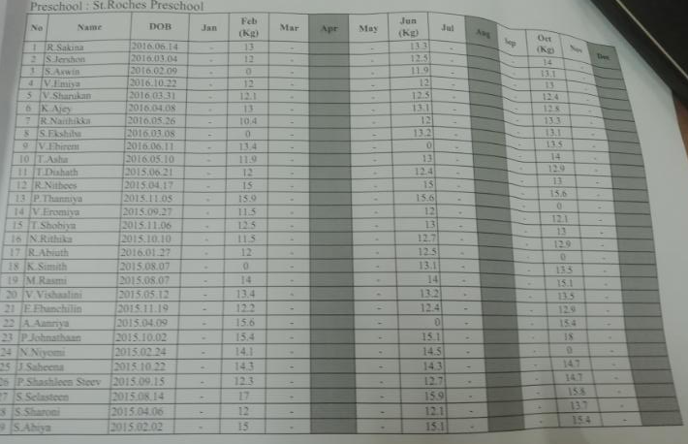
Morning Meals Programme - 2019
MOH Reported about increased weight level

Slide 4
Morning Meals Programme (32 preschools) - 2019
No | Name of the School | No of Students
1 | St.Rocks Pre School | 22
2 | Ambalavanar pre School | 20
3 | Trinity Tiny Tots Pre School | 68
4 | St.Nickles Pre School | 25
5 | Nithiya Oli | 40
6 | Muthamil Pre School | 40
7 | Annai Velankanni Preschool | 25
8 | Colombuthurai East preschool | 20
9 | Colombuthurai West preschool | 43
10 | Koiyathoda community preschool | 14
11 | Thiyoku preschool | 20
12 | Thodarmaadi preschool (flats) | 20
13 | Avemaria preschool | 70
14 | Kurunagar Community preschool | 40
15 | Holycross preschool | 35
16 | City mission Preschool | 16
No | Name of the School | No of Students
17 | St,Antonys Preschool | 32
18 | Vanathomas preschool | 10
19 | St maries preschool Mathews Punitha mariyannai | 30
20 | Somasuntharam preschool | 20
21 | St.Annes preschool | 21
22 | Trinity Tiny Tots Pre School Rasavinthodam | 26
23 | Sivan Preschool | 06
24 | Gnanakkulanthi preschool | 44
25 | St.Peters preschool | 16
26 | Koddady Meenadchi preschool | 12
27 | Vilunri vinagagar preschool | 35
28 | Kalaivani preschool | 23
29 | St maries preschool Navanthura | 34
30 | Al Azhkar preschool | 20
31 | Arivoli preschool | 32
32 | Iqra preschool | 27

Slide 5
Monthly Expenditure for Morning Meals Programme - 2019
No | Month | No of School
1 | January | 06
2 | February | 06
3 | March | 06
4 | April
5 | May | 06
6 | June | 06
7 | July | 06
8 | August
9 | September | 32
10 | October | 32
11 | November | 32
12 | December

Slide 6

  Awareness Programme
  “Aruna Thakida Rada” Drawing Competition
“mUz jfpl ulh”
Kd;gs;sp khztu;fSf;fhd rpj;jpu fz;fhl;rp - 2019
,lk; : khtl;l Kfhikj;Jt mgptpUj;jp gapw;rp epiyak;
(District Management Development Training Centre)
gioa g+q;fh tPjp> aho;g;ghzk;.
jpfjp : 2019.03.29
Neuk; : 9.00am – 12.10pm
epjp xJf;fPL : 18,000/-

Slide 7
  Awareness Programme
  2. “Velikeliyan Pidu Atharata”
“ntypnfypad; gpL mjul” rpWtu; Nea fy;tp gw;wpa tpopg;gzu;T khjpupr; nraw;jpl;lk; - 2019 ,lk; : khtl;l Kfhikj;Jt mgptpUj;jp gapw;rp epiyak; (District Management Development Training Centre) gioa g+q;fh tPjp> aho;g;ghzk;. jpfjp : 2019.04.04 Neuk; : 9.00am – 02.10pm epjp xJf;fPL : 25,000/-

Slide 8
  Awareness Programme
  3. “Kd;gps;isg;gUt Njrpa thuk;”
Kd;gps;isg;gUt guhkupg;G kw;Wk; Njrpa thuk; 2019 ,lk; : gioa g+q;fh> aho;g;ghzk; (Old Park) jpfjp : 2019.07.15 (jpq;fl;fpoik) Neuk; : 9.00am – 01.00pm epjp xJf;fPL : 20,000/-

Slide 9
  Awareness Programme
  4. “Lets Protect Children”
  “rpWtu;fisg; ghJfhg;Nghk; Ntiyj;jpl;lk;”
Early Childhood Development Programme for Pregnant Mothers at Pommaiveli Clinic – 23.08.2019
Early Childhood Development Programme programme for Preschool Parents at Trinity Tiny Tot Preschool – 23.08.2019
Awareness programme about healthy life by Dr Thayalini for Preschool parents at Trinity Tiny Tot Preschool
Early Childhood Development Programme for Parents at J/83
GN Division – 23.08.2019

Slide 10
Early Childhood Development Programme for Al azhaar Preschool Parents (J/87) 23.08.2019
Early Childhood Development Programme for Parents at J/82 – 26.08.2019
Early Childhood Development Programme at J/77 – 26.08.2019
Issue of 03 Emergency Pack for Pregnant Mothers
Issue of 03 Indoor play things for 3 Preschools - Annai Velankanni,
                - Muthamil,
                - Gnanakulanthai Preschools)
Early Childhood Development Programme for Preschool parents at Muththamil Preschool – 27.08.2019
Awareness Programme for Parents at J/78
Early Childhood Development Programme for Parents at J/75
Awareness Programme at J/71 Division
Early Childhood Development Programme for Parents at J/80
Issue of Uniform for 160 Preschool Teachers

Slide 11
Early Childhood Development Programme for Parents at J/67
Early Childhood Development Programme for Students at Osmaniya School
Early Childhood Development Programme for Parents at J/65 – 28.08.2019
Early Childhood Development Programme for Preschool Teachers
Awareness Programme for Youths at J/73
Awareness Programme for members of Home of hope on 29.08.2019
Entertainment Programme at Bosco School at J/77
Opening ceremony of Eliloor Annai Velankanni Preschool at J/61 on 30.08.2019
Opening Ceremony at St Rock Preschool at J/68
Issue of Uniform for 40 Preschool Students
Awareness Programme for Parents by Dr Thayalini at J/76
Awareness Programme for Parents at Theebam Tution Centre J/70

Slide 12
  Awareness Programme
5.“ngw;Nwhiu tpopg;g+l;Lk; epfo;r;rpj;jpl;lk;”
“ngw;Nwhiu tpopg;g+l;Lk; epfo;r;rpj;jpl;lk;” Kd;gps;isg;gUt mgptpUj;jp nraw;wpl;lk; ,lk; : FUefu; fyhrhu kz;lgk; (J/69) jpfjp : 21,22,23,24,25 / 10 / 2019 Neuk; : 9.30am – 12.30am epjp xJf;fPL : 37,460/-

Slide 13
  Awareness Programme
  6.Kd;gs;sp fzpg;gPL njhlu;ghd Ntiyj;jpl;lk;”
“Kd;gs;sp Mrpupau;fSf;fhd fzpg;gPL gw;wpa tpopg;Gzu;T - 2019 ,lk; : gpuNjr nrayf khehl;L kz;lgk; gioa g+q;fh tPjp> aho;g;ghzk;. tsthsufs;; : jpU.gj;kFkud;> jpU.tpNdhjud; jpfjp : 26/27.11.2019 Neuk; : 9.00am – 02.00pm epjp xJf;fPL : 31,000/=

Slide 14
  Awareness Programme
  “Kd;gs;sp fzpg;gPL njhlu;ghd Ntiyj;jpl;lk;”
2. Early Childhood Development Project
  “Kd;gs;spfspd; Mff;Fiwe;j juepakq;fis Nkk;gLj;Jk; Ntiyj;jpl;lk;”
Facility Improvement Grant
Fee wafer Programme
Preschool Teachers Training Programme
Parental Awareness Programme

Slide 15

  Early Childhood Development Project
Facility Improvement Grant
  Early Childhood Development Project
  Pre-School – Educational Material…….
  Early Childhood Development Project

Slide 16
  Early Childhood Development Project
  Selected preschool - 2019
City mission Preschool
Avemaria preschool
Holycross preschool
Holy family convent preschool
Thodarmaadi preschool
Gurunagar Community preschool
Vilunri vinagagar preschool
Koddady Meenadchi preschool
St maries preschool
Punitha Mariyannai
St maries preschool
Punitha Mariyal

Slide 17
  Early Childhood Development Project
  Muththamil Gnanakulanthai Pre-School – Renovation works
  Early Childhood Development Project
3. Preschool Teachers Training Programme at Sandilipay
  Early Childhood Development Project
3. Preschool Teachers Training Programme at Kayts

Slide 18
  Early Childhood Development Project
  Parental Awareness Programme
  Early Childhood Development Project
  Field Visit - December
  Annai Velankanni Preschool
  St. Roches Preschool
  St Maries Preschool’s Exhibition
  Ambalavanar Preschool’s Exhibition

Slide 19
Pregnant Mothers Programme - 2018/2019
Month | No of Stamps 2019 | No of Stamps 2018 | Expenditure 2019 (Mn) | Expenditure 2018 (Mn)
Jan | 762 | 578 | 1.524 | 1.156
Feb | 583 | 576 | 1.166 | 1.152
Mar | 569 | 564 | 1.138 | 1.128
Apr | 563 | 615 | 1.126 | 1.23
May | 609 | 682 | 1.218 | 1.364
Jun | 643 | 686 | 1.286 | 1.372
Jul | 668 | 708 | 1.336 | 1.416
Aug | 656 | 677 | 1.312 | 1.354
Sep | 662 | 665 | 1.324 | 1.33
Oct | 673 | 665 | 1.346 | 1.33
Nov | 676 | 652 | 1.352 | 1.304
Dec | 637 | 417 | 1.274 | 0.834
Total | 7701 | 7485 | 15.402 | 14.970

Slide 20
Pregnant Mothers Programme
120-2-4-1-1501
Allocation | Expenditure | Balance
14,974,000.00 | 16,248,000.00 | (1,274,000.00) Commitment – December
Details | 2018 | 2019
Weight increase (Pregnant mother ) | 7Kg – 8Kg | 10Kg – 12 Kg
Child birth weight (2500>) | 15% | 13%
Reference: MOH , Jaffna
Details | 2018 | 2019
Issued Vouchers | 803 | 817
Child & Women Unit

Slide 22
Monthly Expenditure of Pregnant Mothers Voucher 2018/2019

Slide 23
Pregnant Mother Stamps by GN Divisions - 2019
GN DIVISIONS - DIVISIONSL SECRETARIAT - JAFFNA
Month | JAN | FEB | MAR | APR | MAY | JUN | JUL | AUG | SEP | OCT | NOV | DEC | TOTAL
J/61 | 3 | 4 | 3 | 4 | 1 | 5 | 2 | 2 | 1 | 2 | 3 | 3 | 33
J/62 | 2 | 2 | 1 | 4 | 2 | 1 | 0 | 1 | 2 | 1 | 1 | 3 | 20
J/63 | 2 | 3 | 3 | 0 | 5 | 0 | 0 | 2 | 3 | 2 | 1 | 2 | 23
J/64 | 2 | 3 | 1 | 1 | 1 | 2 | 0 | 1 | 1 | 2 | 1 | 1 | 16
J/65 | 0 | 4 | 1 | 4 | 3 | 1 | 2 | 0 | 0 | 3 | 1 | 0 | 19
J/66 | 1 | 3 | 3 | 1 | 5 | 4 | 1 | 2 | 4 | 1 | 4 | 1 | 30
J/67 | 3 | 2 | 1 | 2 | 0 | 4 | 1 | 0 | 5 | 0 | 2 | 0 | 20
J/68 | 11 | 3 | 7 | 10 | 9 | 12 | 8 | 3 | 7 | 0 | 5 | 11 | 86
J/69 | 3 | 9 | 8 | 6 | 6 | 7 | 3 | 2 | 4 | 4 | 2 | 6 | 60
J/70 | 1 | 2 | 1 | 1 | 3 | 1 | 1 | 1 | 2 | 0 | 0 | 3 | 16
J/71 | 2 | 5 | 2 | 3 | 1 | 2 | 4 | 2 | 0 | 1 | 1 | 3 | 26
J/72 | 2 | 1 | 2 | 1 | 1 | 1 | 0 | 0 | 2 | 0 | 0 | 1 | 11
J/73 | 3 | 4 | 1 | 0 | 2 | 1 | 2 | 0 | 2 | 0 | 1 | 2 | 18
J/74 | 0 | 2 | 1 | 3 | 5 | 3 | 2 | 1 | 4 | 1 | 2 | 0 | 24
J/75 | 2 | 3 | 1 | 4 | 1 | 2 | 2 | 3 | 3 | 0 | 3 | 0 | 24
J/76 | 0 | 2 | 3 | 0 | 1 | 1 | 2 | 4 | 0 | 1 | 1 | 1 | 16
J/77 | 2 | 2 | 3 | 1 | 0 | 1 | 3 | 1 | 0 | 1 | 2 | 1 | 17
J/78 | 3 | 1 | 0 | 2 | 3 | 0 | 6 | 1 | 2 | 3 | 7 | 2 | 30
J/79 | 1 | 2 | 2 | 0 | 1 | 4 | 1 | 0 | 2 | 0 | 1 | 0 | 14
J/80 | 0 | 2 | 2 | 1 | 2 | 3 | 0 | 0 | 3 | 2 | 0 | 2 | 17
J/81 | 2 | 3 | 4 | 3 | 2 | 4 | 2 | 4 | 2 | 3 | 2 | 4 | 35
J/82 | 0 | 1 | 2 | 0 | 2 | 1 | 4 | 1 | 2 | 1 | 2 | 2 | 18
J/83 | 3 | 1 | 0 | 2 | 1 | 2 | 0 | 2 | 1 | 2 | 2 | 0 | 16
J/84 | 1 | 3 | 4 | 3 | 3 | 5 | 3 | 2 | 1 | 2 | 2 | 4 | 33
J/85 | 1 | 3 | 4 | 7 | 7 | 3 | 8 | 2 | 4 | 2 | 6 | 5 | 52
J/86 | 3 | 2 | 1 | 7 | 6 | 2 | 2 | 1 | 2 | 4 | 3 | 0 | 33
J/87 | 6 | 6 | 12 | 1 | 4 | 2 | 12 | 1 | 1 | 11 | 7 | 1 | 64
J/88 | 4 | 2 | 1 | 2 | 1 | 2 | 1 | 1 | 0 | 3 | 3 | 3 | 23
TOTAL | 63 | 80 | 74 | 73 | 78 | 76 | 72 | 40 | 60 | 52 | 65 | 61 | 794

Slide 24
4.Other Activities …….
1.Drawing Works at Child & Women Unit
  2.UNFBA issued packs for Pregnant mothers

