Slide 1
DIVISIONAL SECRETARIAT – JAFFNA
FISHERIES
Development Programe Progress
2019

Slide 2
Divisional Secretariat- Jaffna Gurunagar Off shore Stratergy Development project -2018,2019
S.N | Description of work | G.N. Division | Source of Fund | TEC | Allocation for the year (Rs.) | Total Expenditure (Rs.)
 |  |  |  | (Rs. in mn)
1. | Construction of Sorting Hall | J/69 | Ministry of National Policies | 18.34 | 17,270,807.84 | 16,320,689.15
2. | Construction of Sales outlet | J/69 | Ministry of National Policies | 3.00 | 2,480,897.35 | 2,473,499.21
3. | Construction of Mending Hall | J/69 | Ministry of National Policies | 12.34 | 9,520,342.88 | 9,520,342.88
4. | Construction of Fuel Station | J/69 | Ministry of National Policies | 11.09 | 13,217,765.59 | 12,366,560.01
5. | Construction of Auction Building | J/69 | Ministry of National Policies | 14.98 | 14,550,000.00 | 9,200,046.88
6. | Construction of Gurunagar Jetty Retaining wall and Approach Road Development | J/69 | Ministry of Fisheries Aquatic Resources | 3.74 | 3,784,000.00 | 3,784,000.00
7. | Reconstruction of Mending Hall | J/69 | Ministry of Fisheries | 2.00 | 2,000,000.00 | 1,980,000.00
Total |  |  |  | 65.49 | 62,823,813.66 | 55,645,138.13

Slide 3
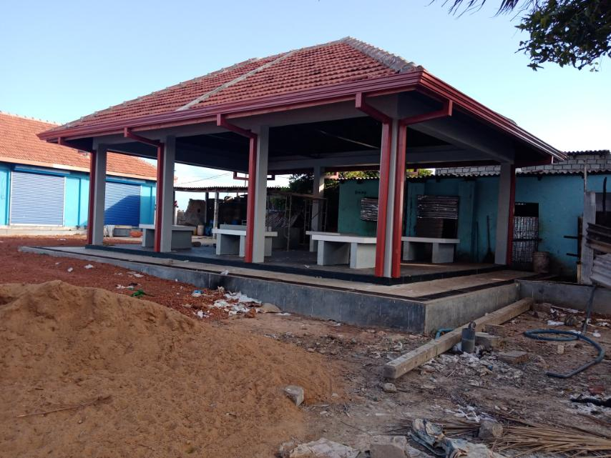
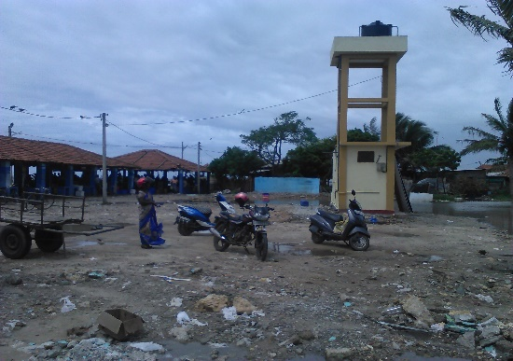
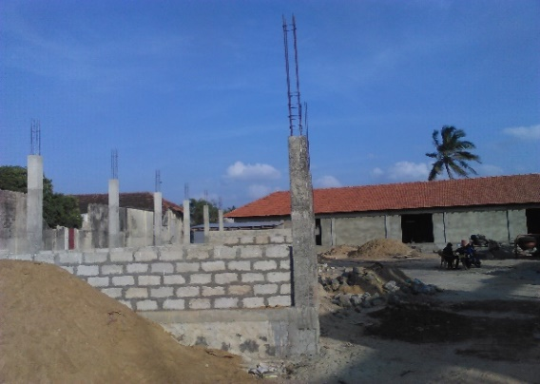
DIVISIONAL SECRETARIAT - JAFFNA
Ministry of National Policies, Economic Affairs, Resettlement & Rehabilitation, Northern Province Development , Vocational Training & Skills Development & Youth Affairs.
Name of the Programme : Development of Offshore Strategic infrastructure Facilities at Gurunagar in Jaffna District -2019
Name of the Project : Construction of Sorting Hall
Vote Head : 104-02-14-30-2202-0-11
3. D.S.Division : Jaffna
4. G.N.Division : J/69
5. Implementing Agency : DS office Jaffna
6. Total Allocation Rs : Rs 18,062,740.72
7. Total Estimate cost Rs : Rs 18,062,740.72
Total Expenditure : 8,070,978.45
Bill in Hands :9,276,080.40
10. Name of Contractor : Linham Building Construction , Koiyathoddam
11. Date of Awarding : August 2019
12. Date of Completion : December 2019
13. Physical Progress (%) : 100%
14. No of Beneficiaries : 3000Families

Slide 4

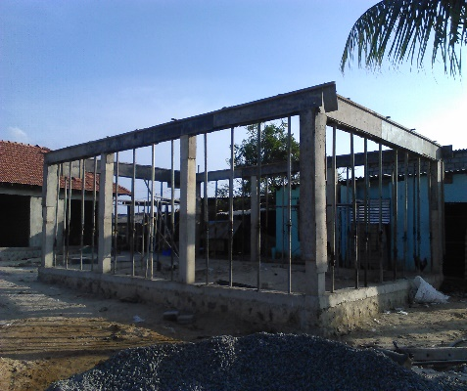
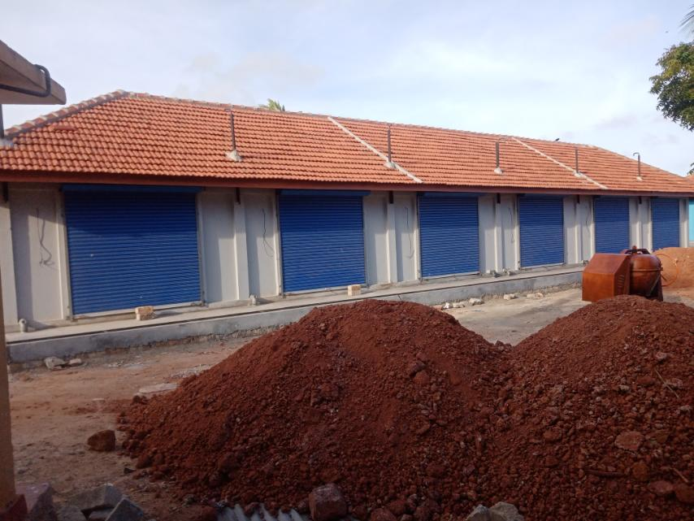
DIVISIONAL SECRETARIAT - JAFFNA
Ministry of National Policies, Economic Affairs, Resettlement & Rehabilitation, Northern Province Development , Vocational Training & Skills Development & Youth Affairs.
Name of the Programme : Development of Offshore Strategic infrastructure Facilities at Gurunagar in Jaffna District -2019
Name of the Project : Construction of Sales Outlet
Vote Head : 104-02-14-30-2202-0-11
3. D.S.Division : Jaffna
4. G.N.Division : J/69
5. Implementing Agency : DS office Jaffna
6. Total Allocation Rs : Rs 2,480,897.35
Total Estimate cost Rs : Rs 2,480,897.35
Total Expenditure : Rs 52,785.05
Bill in hands : Rs.2,420,714.16
10. Name of Contractor :M.S.Kones Construction, Pandatharippu
11. Date of Awarding : August 2019
12. Date of Completion : December 2019
13. Physical Progress (%) : 100%
14. No of Beneficiaries : 3000Families

Slide 5
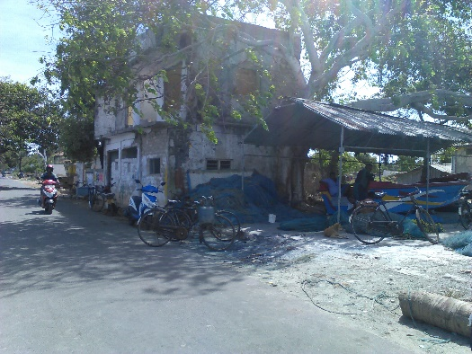
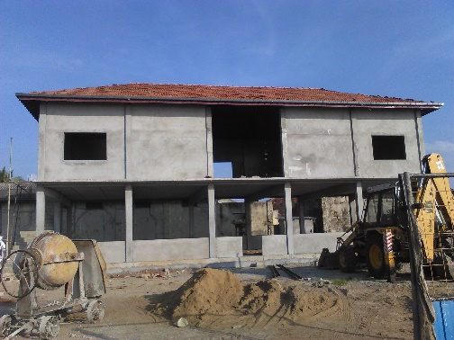
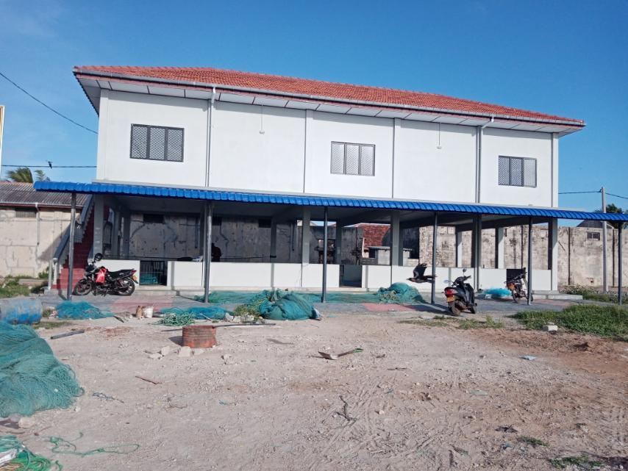
DIVISIONAL SECRETARIAT - JAFFNA
Ministry of National Policies, Economic Affairs, Resettlement & Rehabilitation, Northern Province Development , Vocational Training & Skills Development & Youth Affairs.
Name of the Programme : Development of Offshore Strategic infrastructure Facilities at Gurunagar in Jaffna District -2019
Name of the Project : Construction of Mending Hall
Vote Head : 104-02-14-30-2202-0-11
3. D.S.Division : Jaffna
4. G.N.Division : J/69
5. Implementing Agency : DS office Jaffna
6. Total Allocation Rs : Rs.8,728,410.00
7. Total Estimate cost Rs : Rs.8,728,410.00
Total Expenditure : Rs.2,302,178.84
Bill in hands :Rs.6,425,731.16
Name of Contractor : Matrix Engineering, Vavuniya
11. Date of Awarding : August 2019
12. Date of Completion : December 2019
13. Physical Progress (%) : 100%
14. No of Beneficiaries : 3000Families

Slide 6
DIVISIONAL SECRETARIAT - JAFFNA
Ministry of National Policies, Economic Affairs, Resettlement & Rehabilitation, Northern Province Development , Vocational Training & Skills Development & Youth Affairs.
Name of the Programme : Development of Offshore Strategic infrastructure Facilities at Gurunagar in Jaffna District -2019
Name of the Project : Construction of Fuel Station
Vote Head : 104-02-14-30-2202-0-11
3. D.S.Division : Jaffna
4. G.N.Division : J/69
5. Implementing Agency : DS office Jaffna
6. Total Allocation Rs : Rs.13,358,000.00
7. Total Estimate cost Rs : Rs .13,358,000
Total Expenditure : Rs.3,326,794.42
Bill in hands :Rs. 9,180,000.00
Name of Contractor : M/S Helmen Engineering works
11. Date of Awarding : October 2019
12. Date of Completion : December 2019
13. Physical Progress (%) : 100%
14. No of Beneficiaries : 3000Families

Slide 7
DIVISIONAL SECRETARIAT - JAFFNA
Ministry of National Policies, Economic Affairs, Resettlement & Rehabilitation, Northern Province Development , Vocational Training & Skills Development & Youth Affairs.
Name of the Programme : Development of Offshore Strategic infrastructure Facilities at Gurunagar in Jaffna District -2019
Name of the Project : Construction of Auction Building
Vote Head : 104-02-14-30-2202-0-11
3. D.S.Division : Jaffna
4. G.N.Division : J/69
5. Implementing Agency : DS office Jaffna
6. Total Allocation Rs : Rs 14,550,000.00 (UNDP)
7. Total Estimate cost Rs : Rs 14,550,000.00
Total Expenditure : Rs.2,738,377.03
Bill in hands :Rs.11,811,622.97
10. Name of Contractor : M.S.Kones Construction, Pandatharippu
11. Date of Awarding : June 2019
12. Date of Completion : November 2019
13. Physical Progress (%) : 100%
14. No of Beneficiaries : 3000Families

Slide 8
DIVISIONAL SECRETARIAT - JAFFNA
Ministry of Agriculture, Rural Economic Affairs, Irrigation and Fisheries & Aquatic Resources Development
Name of the Programme : Lagoon Conservation & Development Project
Name of the Project : Renovation of Jetty at Gurunagar for small Boats
Vote Head : 118-2-14-64-2509
3. D.S.Division : Jaffna
4. G.N.Division : J/69
5. Implementing Agency : DS office Jaffna
6. Total Allocation Rs : Rs 3,746,160.00
Total Estimate cost Rs : Rs 3,746,160.00
Total Expenditure : Rs 37,840.00
Bill in hands :Rs.3,708,320.00
10. Name of Contractor : Jaffna Consortium of Rural Women Development Society’s
11. Date of Awarding : October 2019
12. Date of Completion : December 2019
13. Physical Progress (%) : 100%
14. No of Beneficiaries : 3000Families

Slide 9
DIVISIONAL SECRETARIAT - JAFFNA
Ministry of Agriculture, Rural Economic Affairs, Irrigation and Fisheries & Aquatic Resources Development
Name of the Programme : Lagoon Conservation & Development Project
Name of the Project : Renovation of Net Mending Hall
Vote Head : 118-2-14-64-2509
3. D.S.Division : Jaffna
4. G.N.Division : J/69
5. Implementing Agency : DS office Jaffna
6. Total Allocation Rs : Rs 1,980,000.00
7. Total Estimate cost Rs : Rs 1,980,000.00
Total Expenditure : Rs.520,000.00
Bill in hands :Rs.1,460,000.00
Name of Contractor : Gurunagar Fisheries Development Society
11. Date of Awarding : November 2019
12. Date of Completion : December 2019
13. Physical Progress (%) : 100%
14. No of Beneficiaries : 3000Families

Slide 10
Ministry of National Policies, Economic Affairs, Resettlement & Rehabilitation, Northern Province Development , Vocational Training & Skills Development & Youth Affairs.
Name of the Programme : Purchasing of fishing equipments
Name of the Project : Purchasing of fishing equipment
Vote Head : 104-2-14-48-2202
3. D.S.Division : Jaffna
4. G.N.Division : J/61,J/62, J/64-J/72,J/81,J/83-J/85
5. Implementing Agency : DS office Jaffna
6. Total Allocation Rs : Rs 15,000,000.00
7. Total Estimate cost Rs : Rs 14,999,650.42
Total Expenditure : Rs. nil
Bill in hands :Rs.14,999,650.42
Name of Contractor : Malba rope (pvt) Ltd, Nefad foundation Ltd
11. Date of Awarding : December 2019
12. Date of Completion : December 2019
13. Physical Progress (%) : 100%
14. No of Beneficiaries : 3000Families

